Slide 1
Civil Complaint
Classification
[Machine Learning Technology and Administrative Innovation]
Final Project
Team : Three
연다민, 정윤서, 황정원

Slide 2
Civil Complaint 민원
1. Introduction
Civil complaint refers to citizens' various expressions that request certain actions or answers from administrative agencies. It holds the significance of being the easiest means of administrative relief.

Slide 3
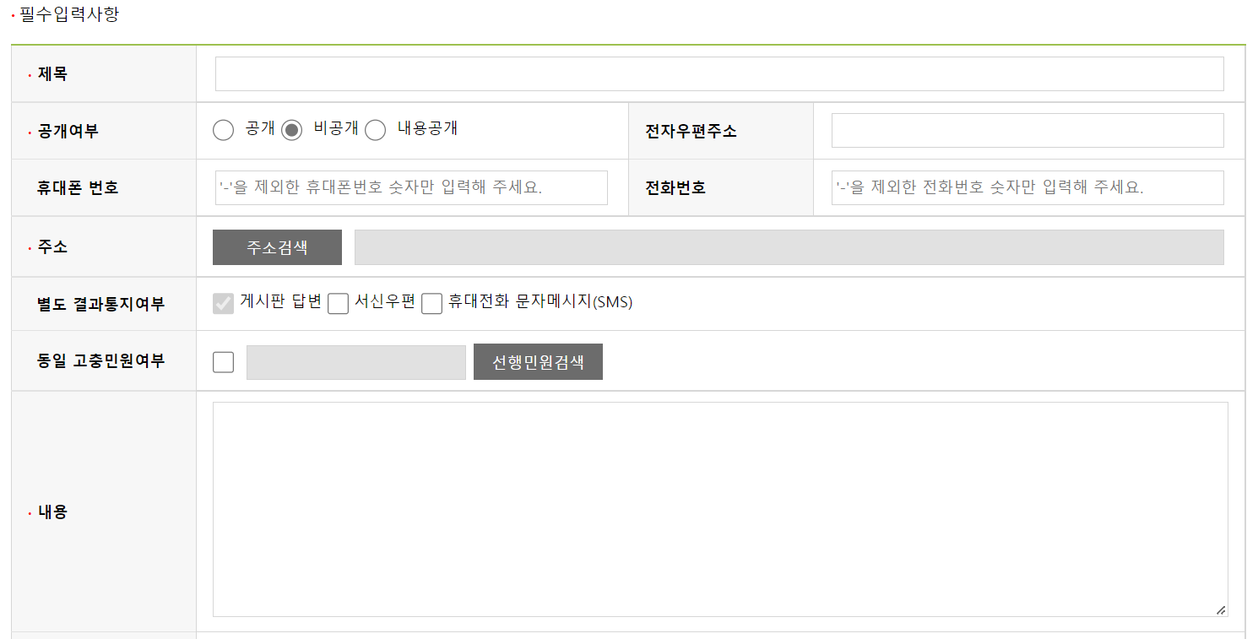
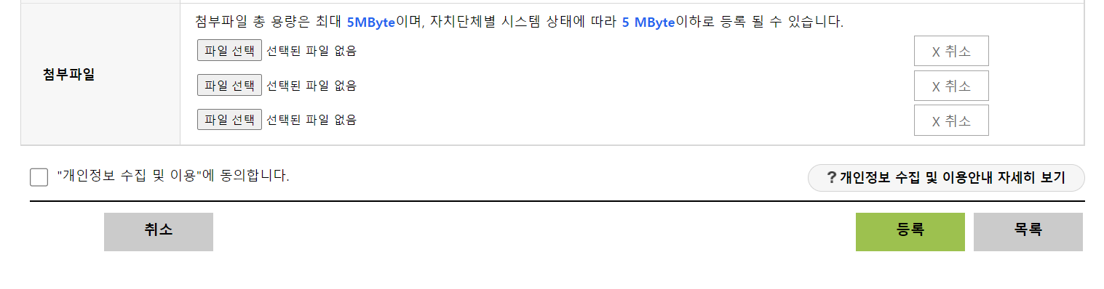
Problem definition
Civil Complaint Submission form

Slide 4
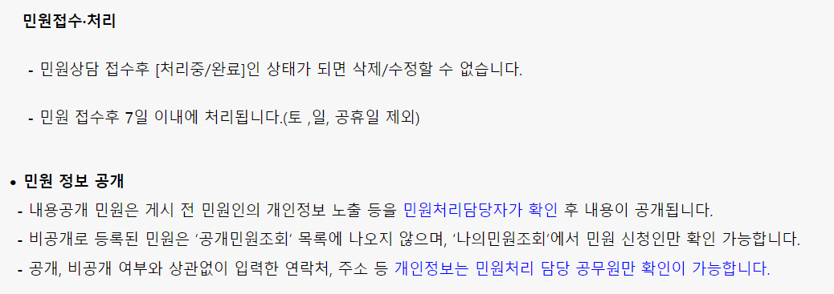
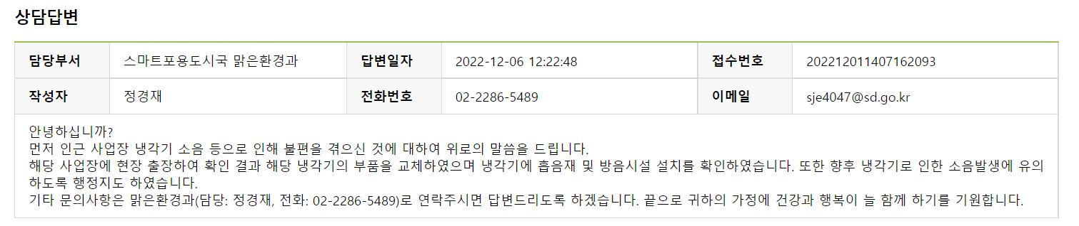
Problem definition
After submission, the civil complaint goes through the confirmation of the district officer and then gets allocated to departments.

Slide 5
Project necessity
This machine learning model will help classify the new Civil Complaints of Seongdong-Gu(성동구) into groups of management department based on existing data. Such a model is meaningful for efficient civil service provision as the current system uses one-by-one manpower. Through this model, the local government will be able to manage complaints efficiently and promptly.

Slide 6
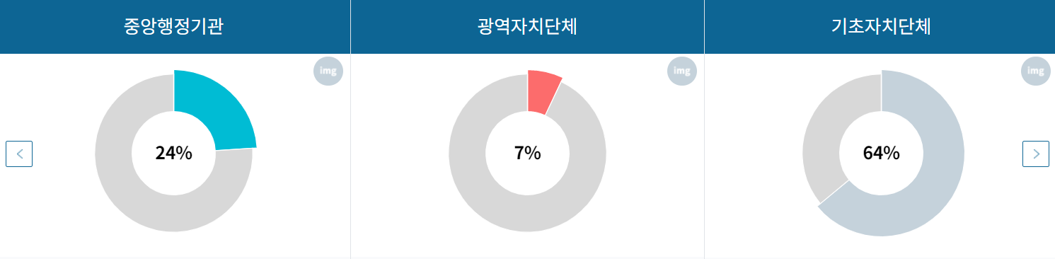
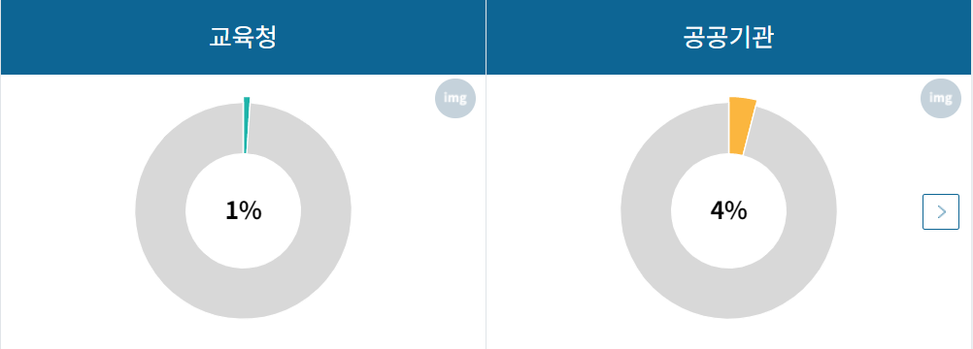
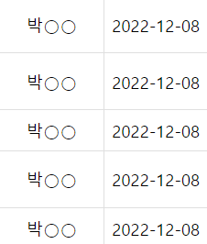
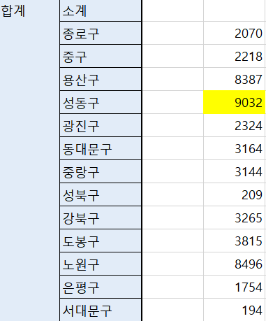
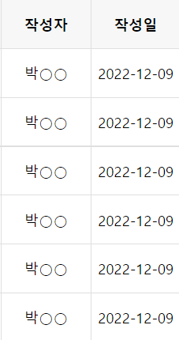
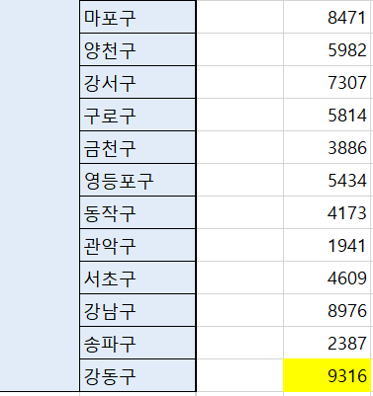

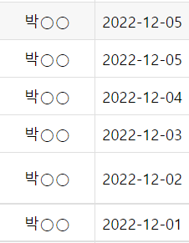
2-1. Data Source
- Local Department → Seongdong-Gu
Districts of Seoul and their Civil Complaints
Contaminated data

Slide 7
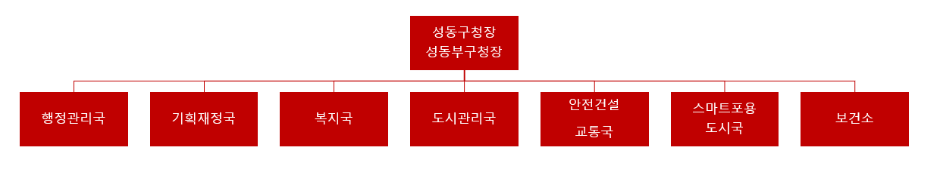
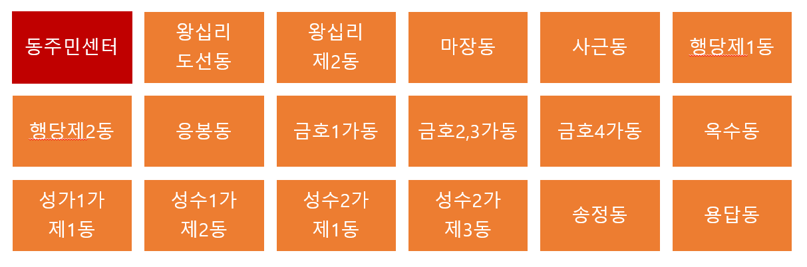
2-1. Data Source
- Local Department → Seongdong-Gu
Division into
8 management departments
: 7 + 1 (17 dong into 1)

Slide 8
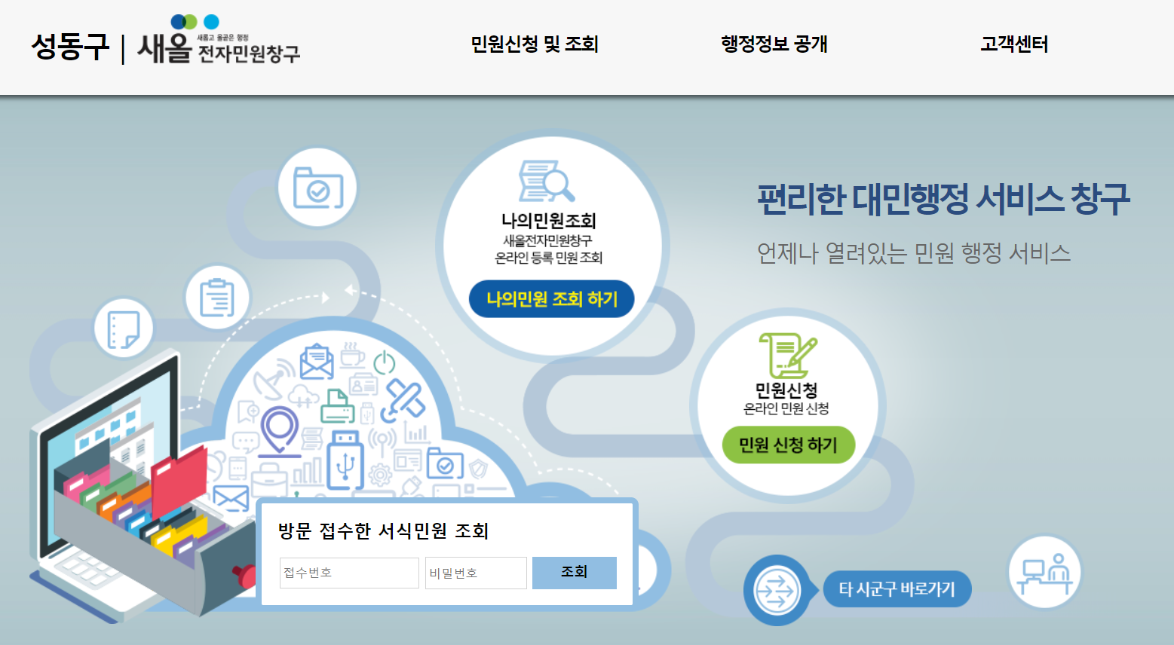
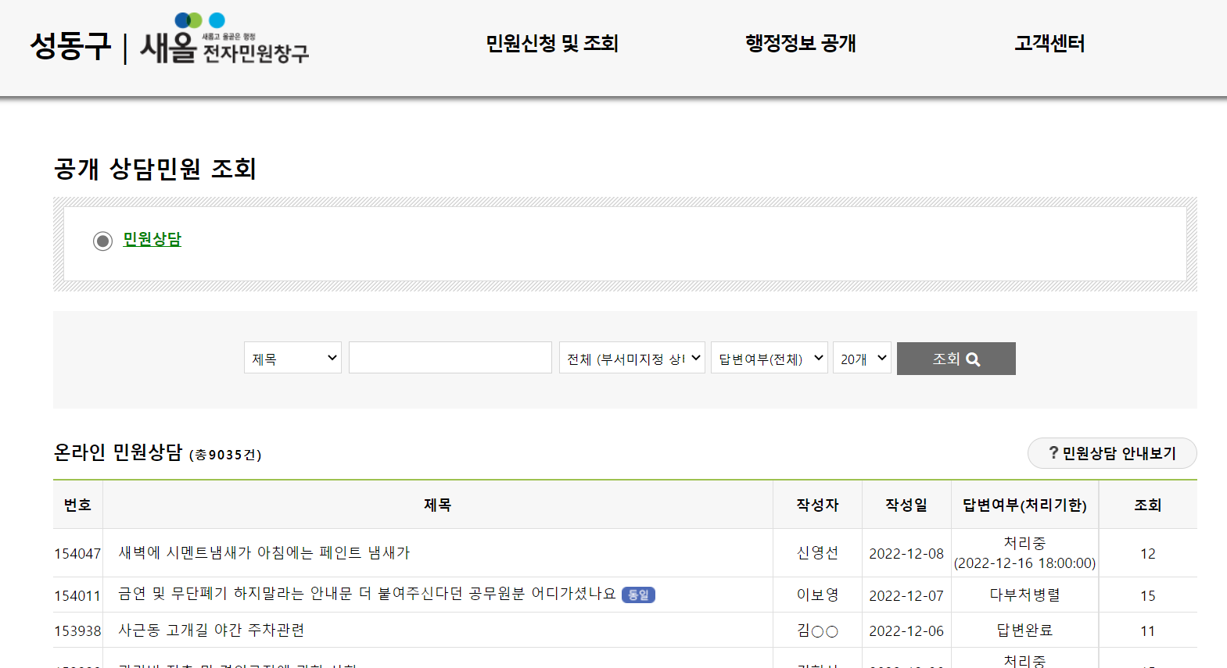
2-1. Data Source
- SaeOl Electronic Civil Service Center

Slide 9
2-2.
Data Collection
Outline
2. Package used:
pyautogui
bs4
selenium
other basic python packages
(pandas, numpy, matplotib)
4. Collection results:
Data: a collection of title/content/type (# elements)
01
02
03
04
3. Data collection method: Web Crawling
Access the Seongdong-gu Office homepage with a Chrome driver
The homepage is secured, so manually click the ‘apply for civil complaints and inquiry (민원신청 및 조회)’ button and the ‘public civil complaints inquiry (공개 상담민원 조회)’ button to access data
⇒ implemented through pyautogui
Click the posts on each page → Move → Collect title/contents/department (as a list) → Move backward
Using for statement, repeat [complete step 2 and click the ‘next page’ button]
⇒ implemented through pyautogui
1. Data collected:
Title, Content, Department in charge
Title: to check how far it was collected in case an error occurs during crawling
Contents: the content of each complaint post
Department in charge: department that each complaint is assigned to

Slide 10
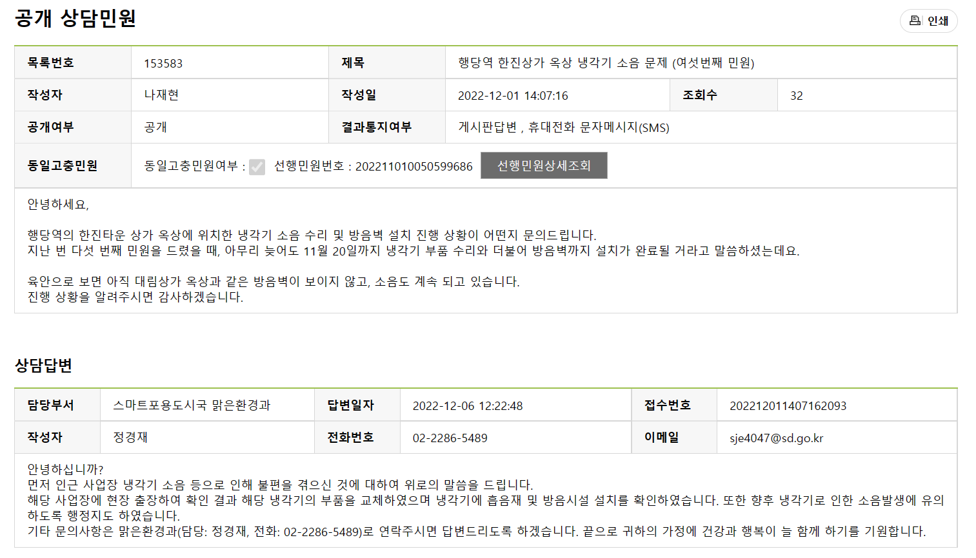
2-2. Data Collection
Example
Title
Content
Department

Slide 11
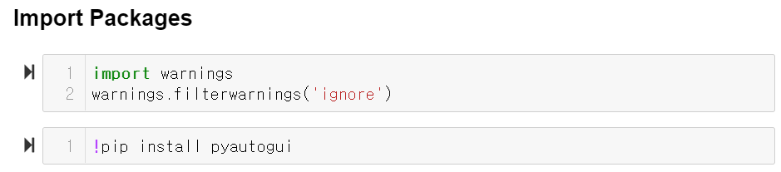
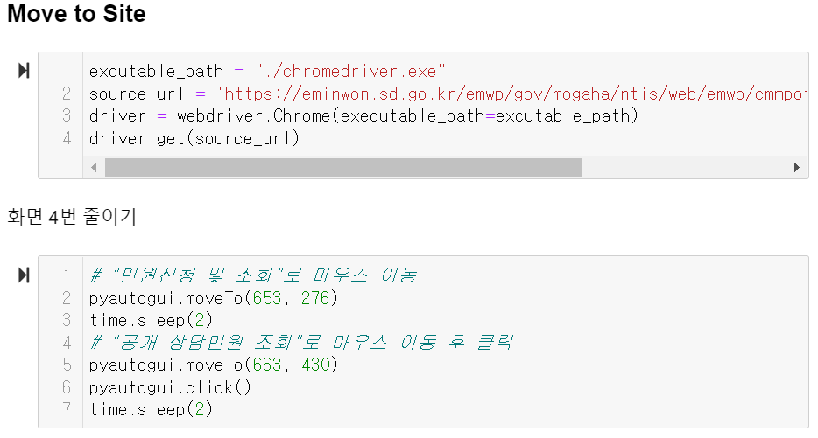
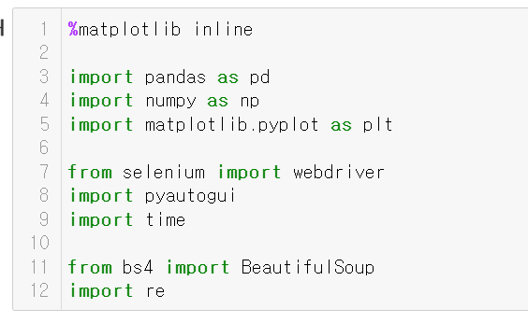
3. Methodology
Data Collection
Notes:
data collection
import packages
move to site – Seongdong-gu Office homepage
in order to be able to see the full screen at a glance – zoom out 4 times (by hand)
move the mouse cursor to the coordinates of the ‘apply for civil complaints and inquiry’ button and ‘public civil complaints’ button

Slide 12
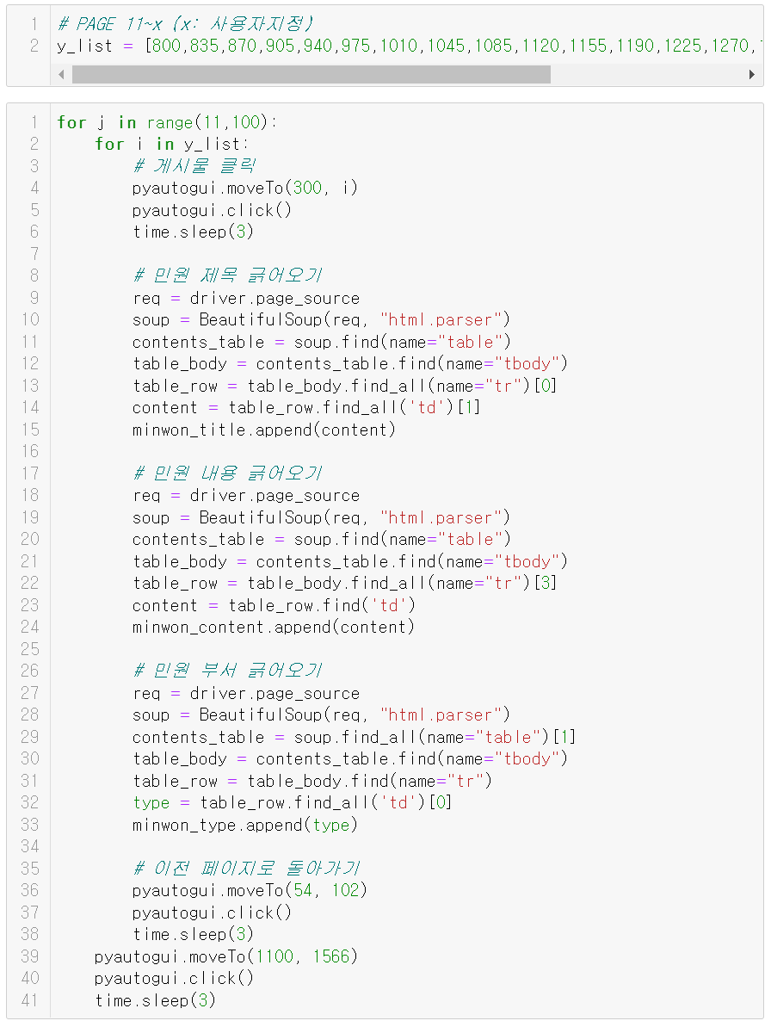
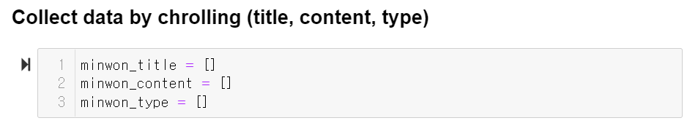
3. Methodology
Data Collection
crawling
Notes:
the mouse cursor will scrape the title, content and department of each civil complaint post
this is done through pyautogui, which is a function that moves the mouse cursor to designated coordinates

Slide 13
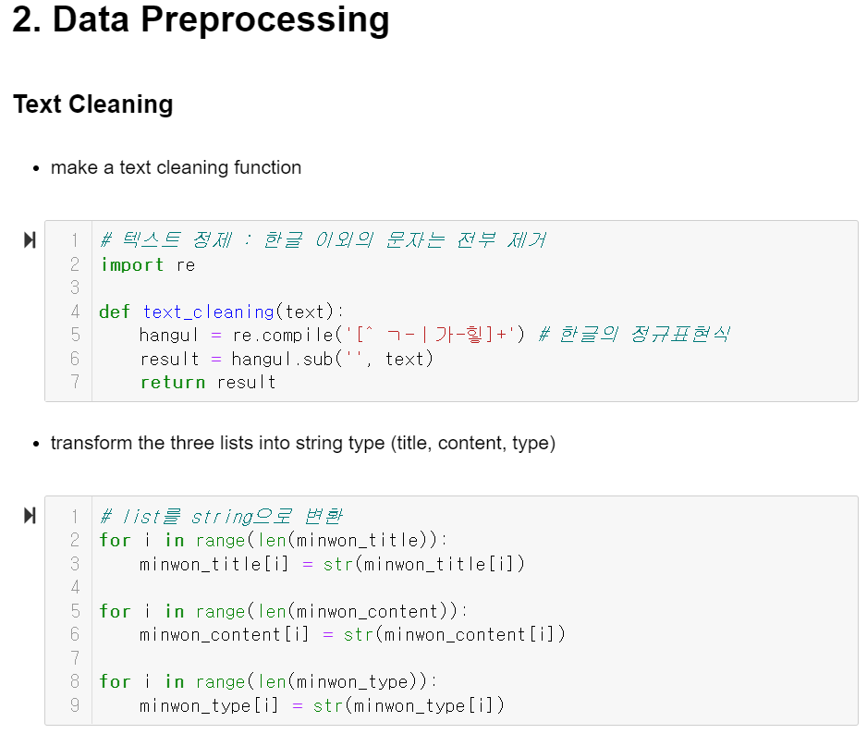
3. Methodology
Data Preprocessing : Text Cleaning
Notes:
Data preprocessing - text cleaning: eliminate all other characters except 한글, korean
for this (text cleaning) to work, it has to be in a string type. (list is not allowed)
so the three lists would have to be transformed into string type

Slide 14
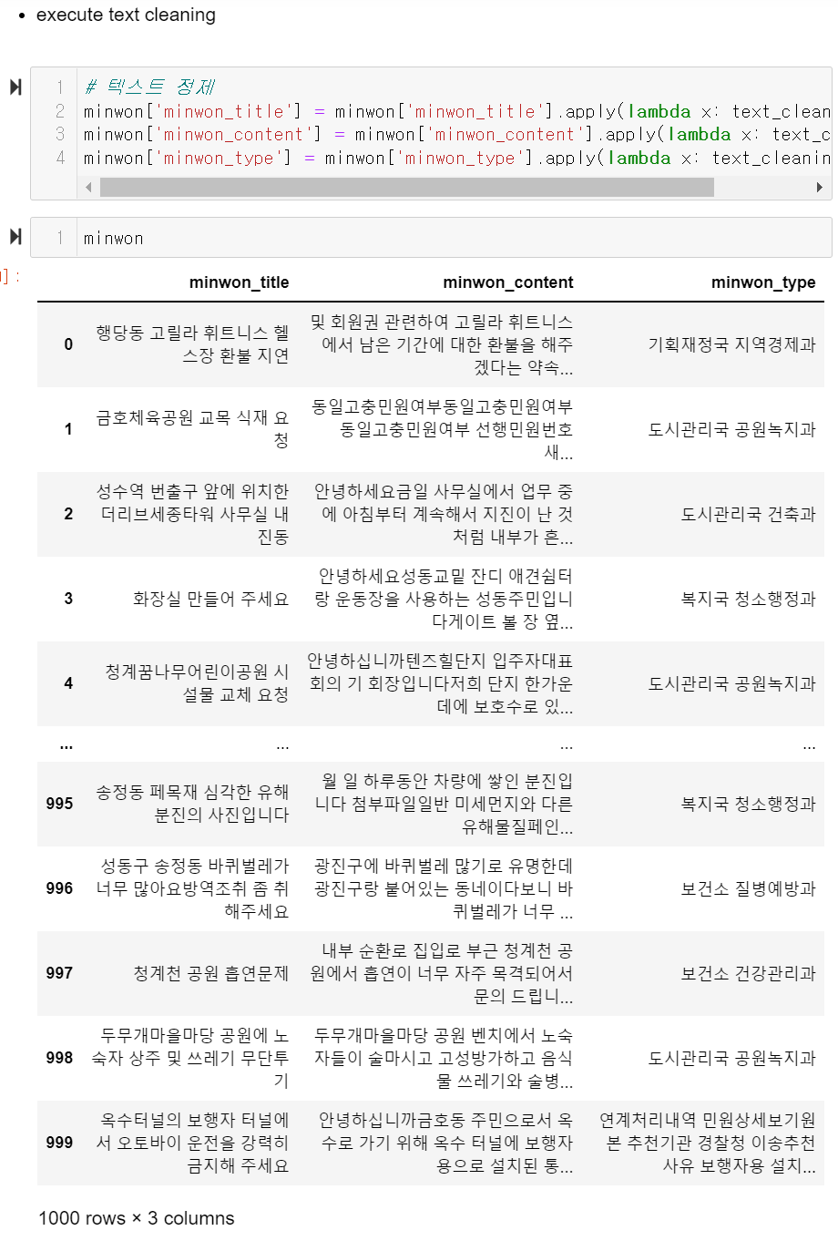
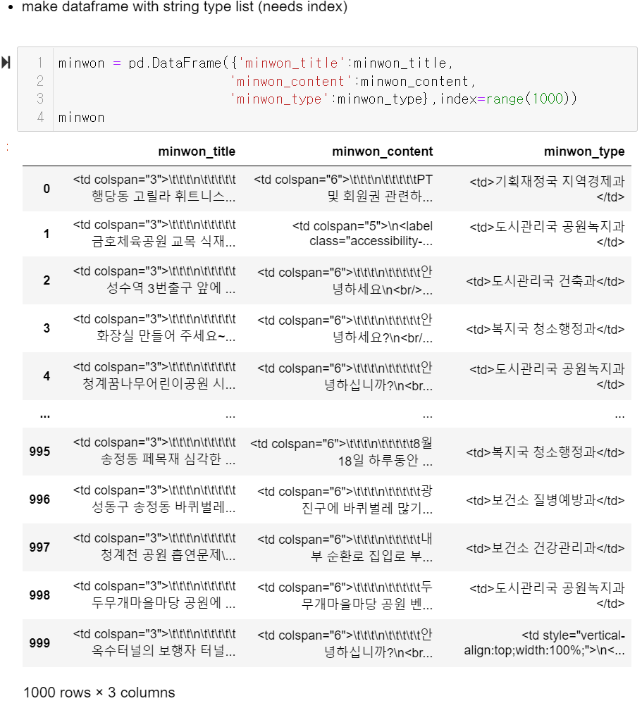
3. Methodology
Data Preprocessing : Text Cleaning
After
Before (raw data)
Notes:
left side - raw data before text cleaning
right side - cleaned data
you can see the difference haha..

Slide 15
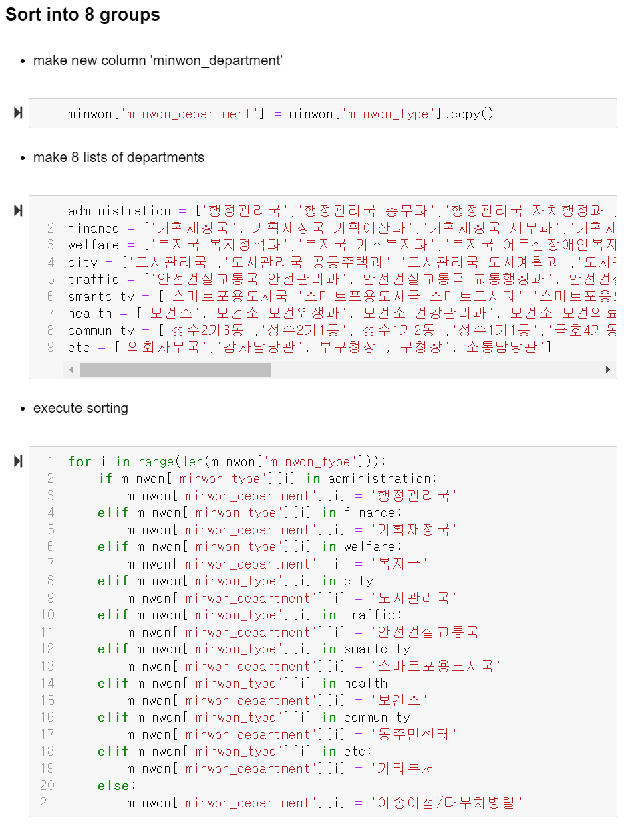
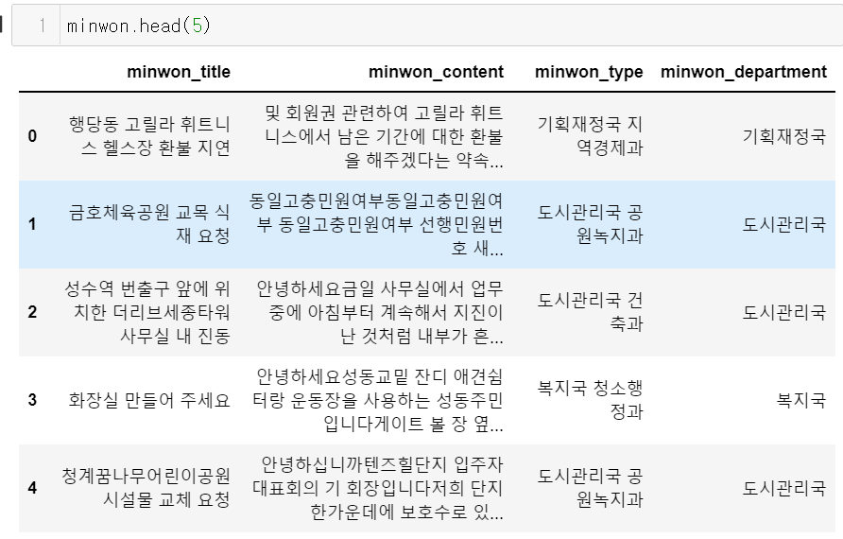
3. Methodology
Data Preprocessing : Sorting
y-variable
Notes:
Made a list of 8 departments
Sorted minwon-type into these 8 departments by creating the feature of minwon_department. This will be used as the y-variable of our model.

Slide 16
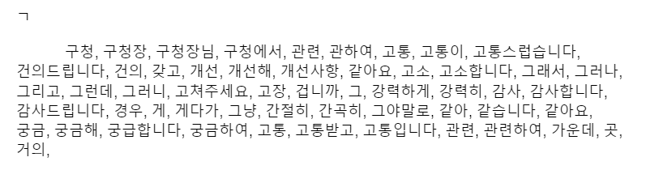
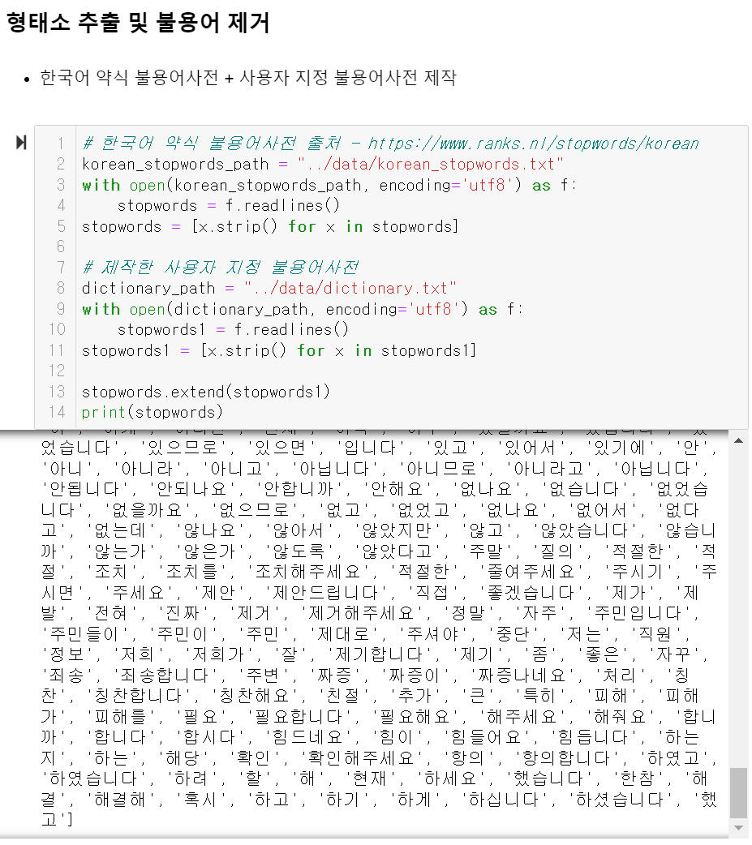
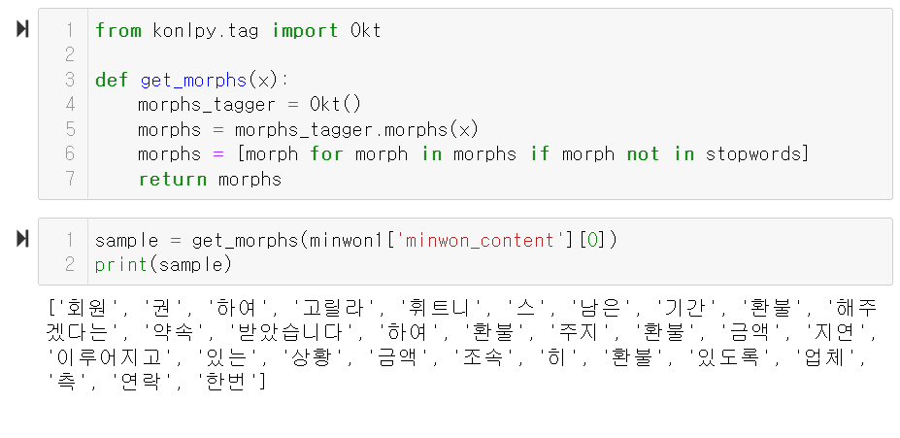
3. Methodology
Data Preprocessing : Stopwords
sample
Notes:
The next stage of data preprocessing: eliminating stopwords
NLTK does not supply korean, so we used the korean version of NLTK, konlpy.
For stopwords, we used a dictionary of Korean stopwords that we got from the internet and a list of stopwords that we have made ourselves.
Sample: applied the elimination of stopwords to a single case of minwon first to check that it works

Slide 17
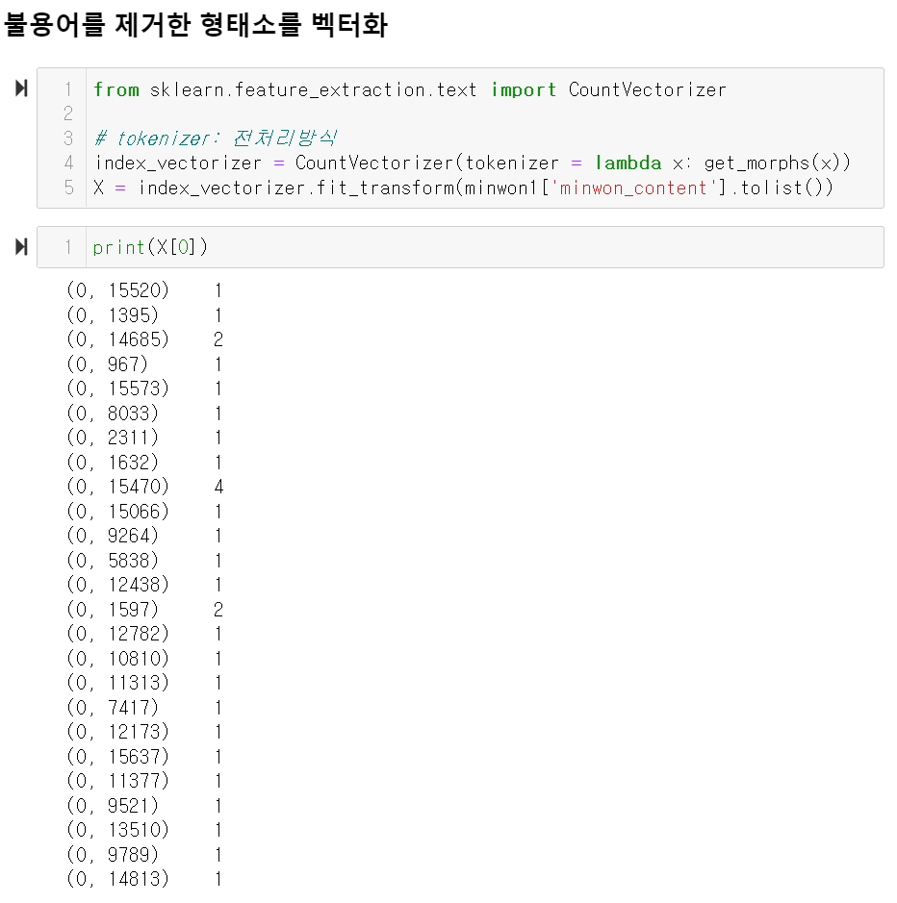
3. Methodology
Data Preprocessing : Stopwords and Vectorization
CountVectorizer: vectorize (transform to number)
tokenizer: decides the method of data processing
=> to use the list that has taken out the stopwords
Notes:
With the list of morephemes after the elimination of stopwords, we will now vectorize each morpheme. Each value in parentheses indicate the serial number for each morpheme. The number beside the serial numbers is the number of times that particular morpheme appeared in the document
Count Vectorizer => vectorize (transform to number)
tokenizer = decides the method of data preprocessing => to use the list that has taken out stopwords
벡터화 – count vector: 횟수를 셈.. 한 쌍의 괄호가 추출한 하나의 형태소를 가르키는 고유번호. 전체문서에서 몇번 출연했는지 카운트하는 게 옆 숫자.

Slide 18
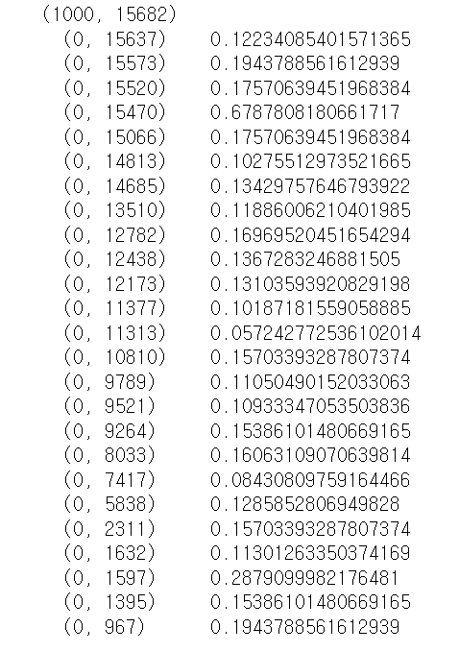
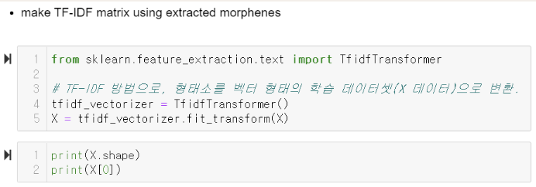
3. Methodology
Data Preprocessing : TF-IDF Matrix
TF: Term Frequency
measures how frequently a term occurs in a document
IDF: Inverse Document Frequency
the inverse measure of document frequency
The higher the value of TF*IDF, the bigger importance the term holds
Notes:
tf - term frequency: measures how frequently a term occurs in a document
idf - inverse document frequency: the inverse measure of document frequency => will measure how frequent the term occurs in other documents as well
so for instance, terms such as “of”, “is”, and in our project, terms, such as, 소음 may appear frequently in our document but would have little importance as it appears frequently in other documents as well. This is what idf is for. Even if the term frequency is high, if it has a high idf, the multiplication of the two values will be small, indicating small importance. So basically, TF-IDF matrix is to discern the real important terms out of all the terms that frequently occurred in the document.
So if you look here on the right, the higher values indicate bigger importance!

Slide 19
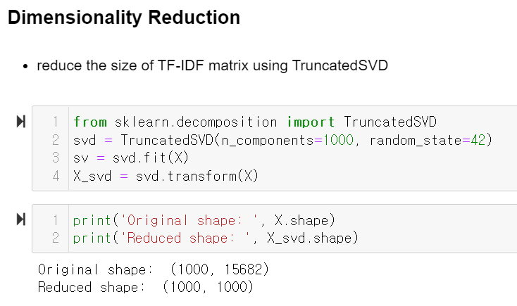
3. Methodology
Dimensionality Reduction
Components: 15800 → 1000
Notes:
TF-IDF matrix: 15800 components -> performed dimensionality reduction to reduce its size to 1000 components

Slide 20
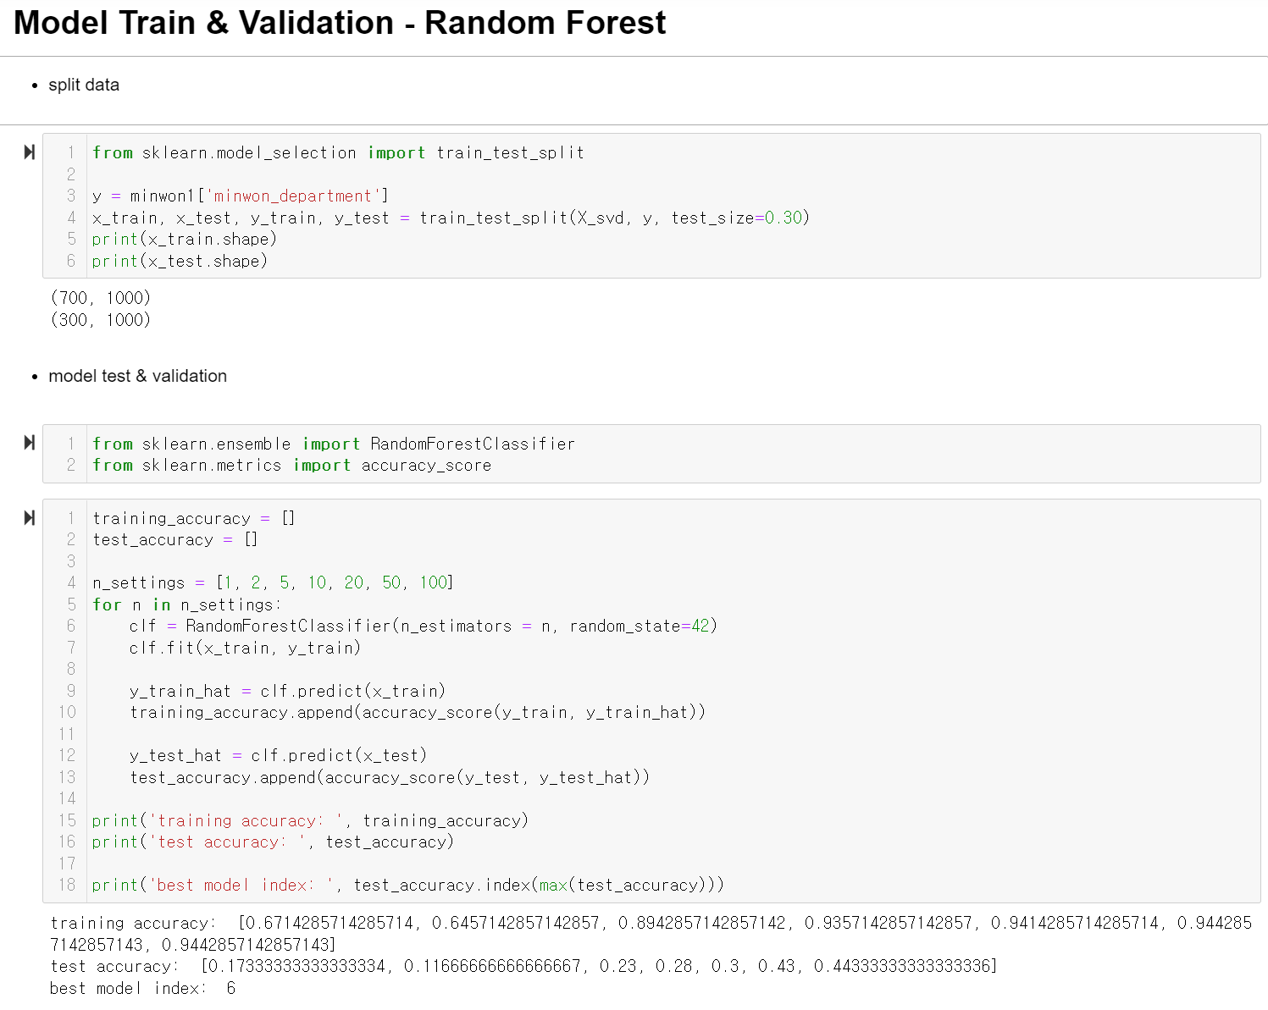
3. Methodology
Random Forest Results
Notes:
train test 7:3 split
random forest – package import + accuracy_score
hyperparameter: n_settings (1, 2, 5, 10….)
각 hyperparameter 별로– index 6번이 0.44로 test accuracy가 가장 높게 나와서 채택!

Slide 21
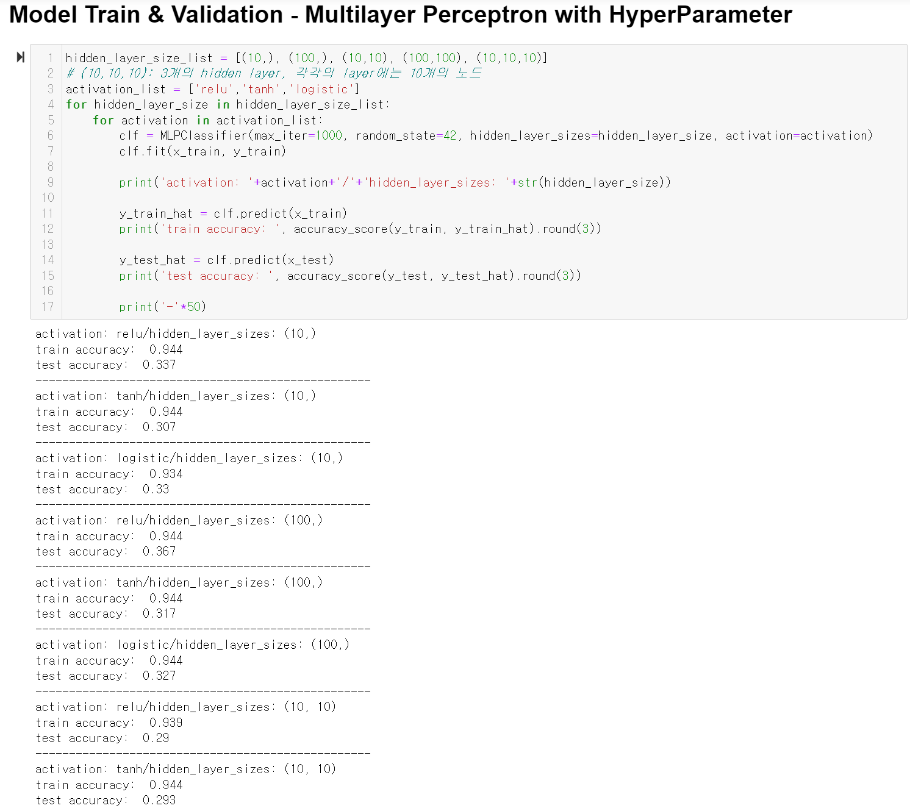
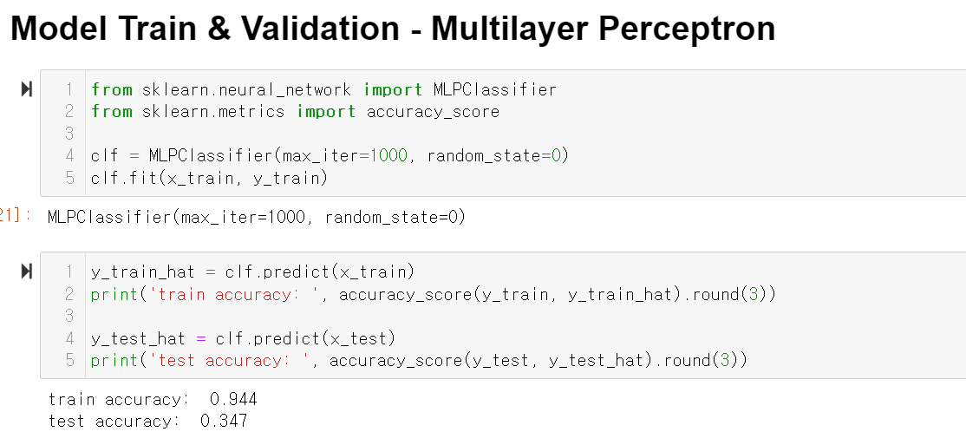
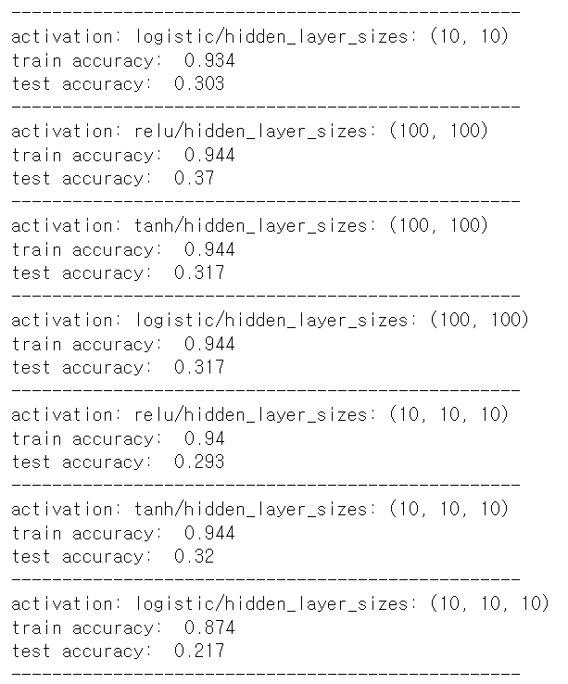
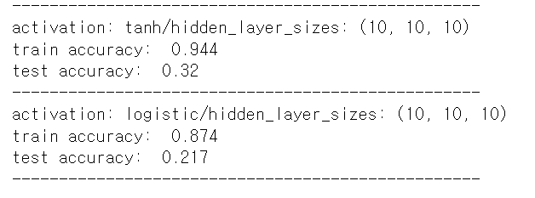
3. Methodology
Multilayer Perceptron Results
Notes:
multilayer perceptron도 실시를 해봤으나 hyperparameter를 설정 하든 안 하든 random forest보다 accuracy가 낮아서 기각~
자세한 hyperparameter에 대한 설명은 뒤에 results 표에서 설명할게요

Slide 22
4. Results
 | Random Forest | Multilayer Perceptron
Hyperparameter | n_settings = [1, 2, 5, 10, 20, 50, 100] | hidden_layer_size_list = [(10,), (100,), (10,10), (100,100), (10,10,10)] activation_list = [‘relu’, ‘tanh’. ‘logistic’]
Train Accuracy | 0.6714285714285714 0.6457142857142857 0.8942857142857142 0.9357142857142857 0.9414285714285714 0.9442857142857143 0.9442857142857143 | (0.944, 0.944, 0.934) (0.944, 0.944, 0.944) (0.939, 0.944, 0.934) (0.944, 0.944, 0.944) (0.94, 0.944, 0.874)
Test Accuracy | 0.17333333333333334 0.11666666666666667 0.23 0.28 0.3 0.43 0.44333333333333336 → Overfitting Problem due to insufficient data | (0.337, 0.307, 0.33) (0.367, 0.317, 0.327) (0.29, 0.293, 0.303) (0.37, 0.317, 0.317) (0.293, 0.32, 0.217)

Slide 23
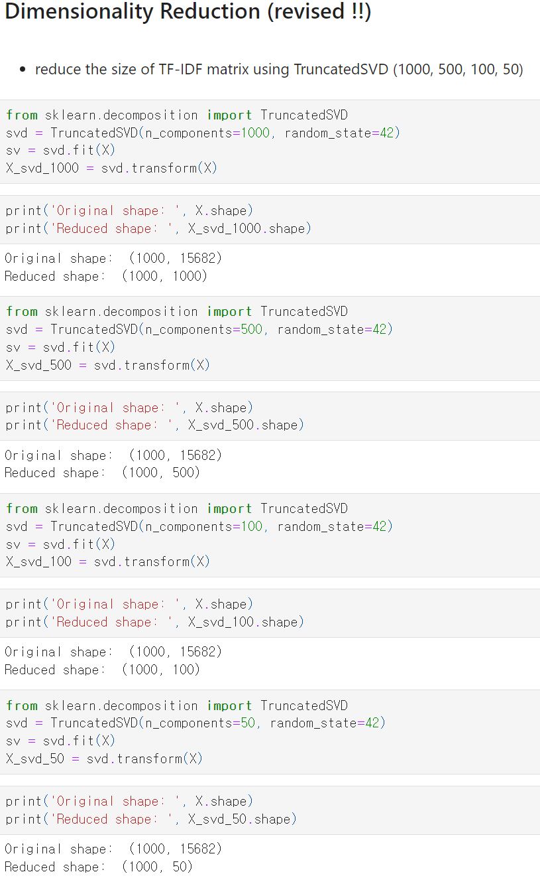
What we REVISED after feedback
: Dimensionality Reduction
#1. Tried dimensionality reduction to 1000, 500, 100, 50

Slide 24
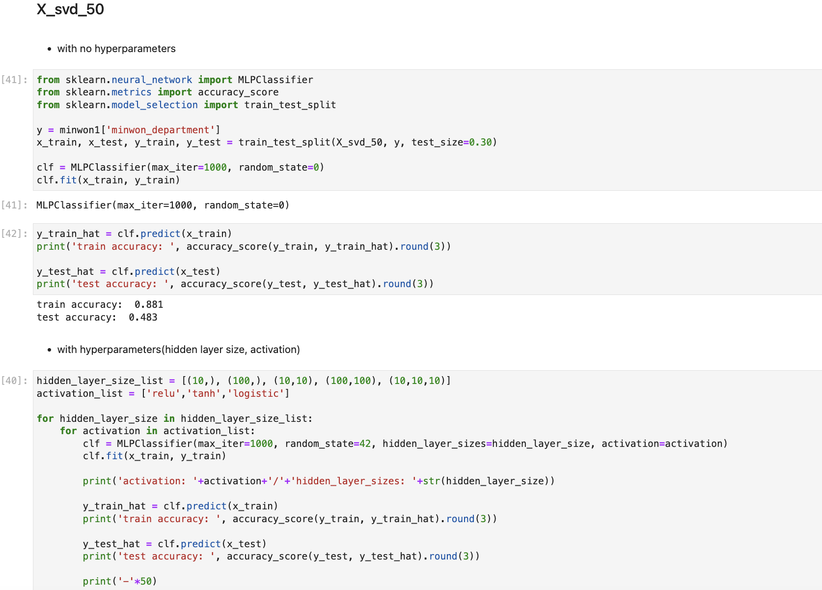
What we REVISED after feedback
: Random Forest & Multilayer Perceptron
#2-1. Tried Random Forest with more trees (100, 150, 200, 250, 300)
#2-2. Applied them each to the differently reduced matrices from #1
#3. Tried Multilayer Perceptron to the differently reduced matrices from #1

Slide 25
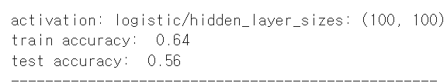
What we REVISED after feedback
: Results
The best result:
-Matrix size reduced to 50
-Multilayer Perceptron
-hidden_layer_size=(100,100)
-activation=logistic
-train accuracy: 0.64
-test accuracy: 0.56
-difference between train accuracy and test accuracy =0.08
=> Higher test accuracy and solved overfitting problem as well !!!

Slide 26
5. Discussion
Implication
Other Districts
Other districts of Seoul (ex Gangdong-gu, Seongbuk-gu etc.) or other local governments can implement this model
ePeople (국민신문고)
ePeople also obtains a massive volume of Civil complaints and can thus, make use of this model
Transfer (이송이첩)
Several civil complaints are transferred to other organizations after submission, and this model can reduce such inefficience

Slide 27
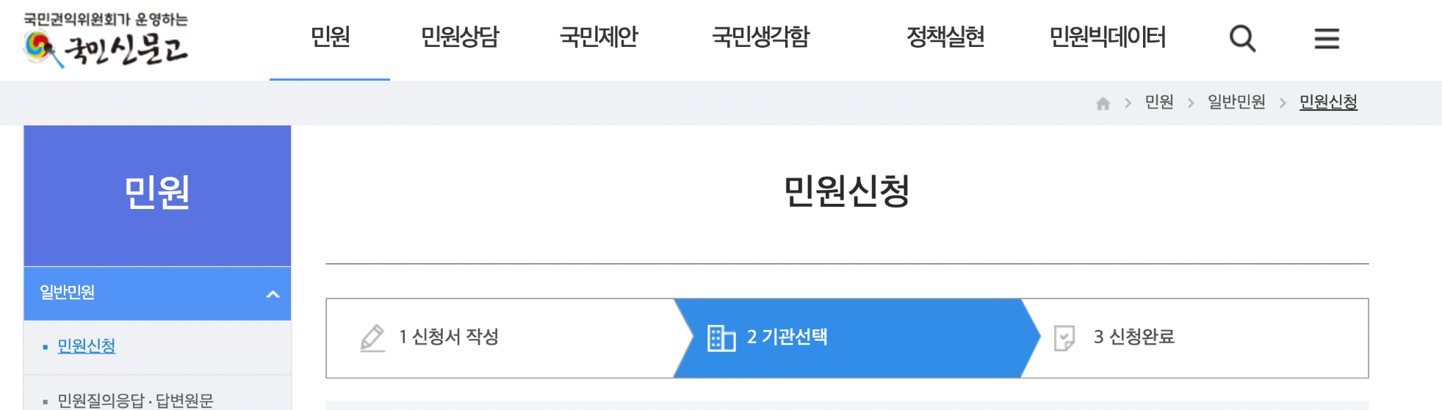
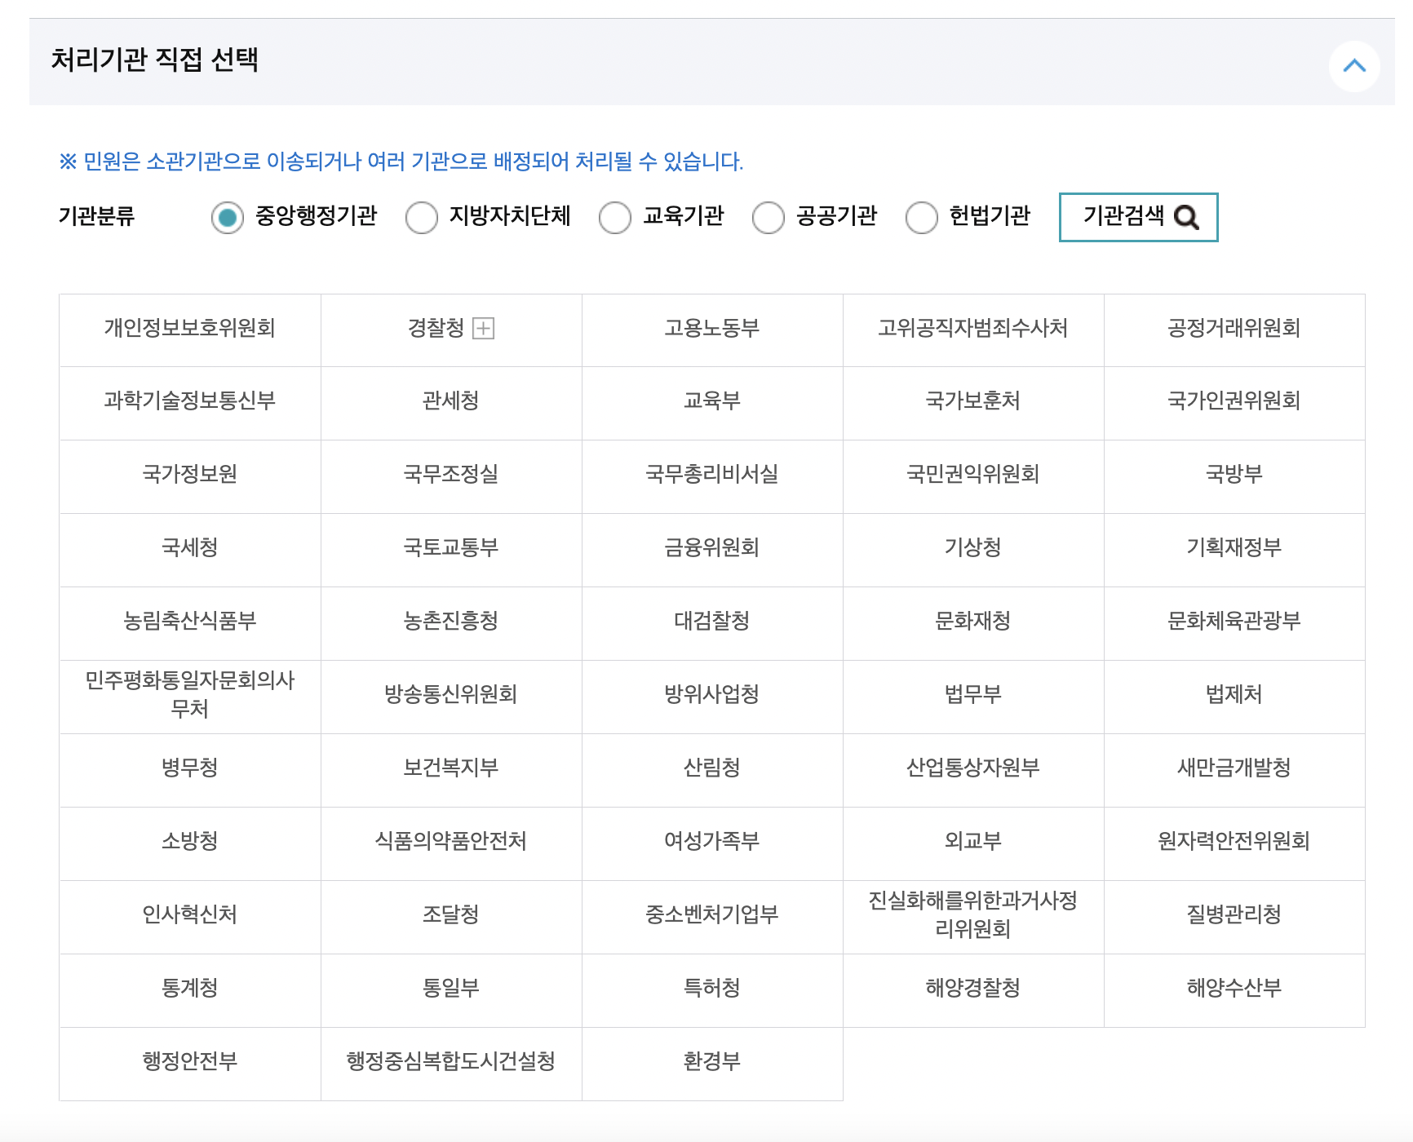
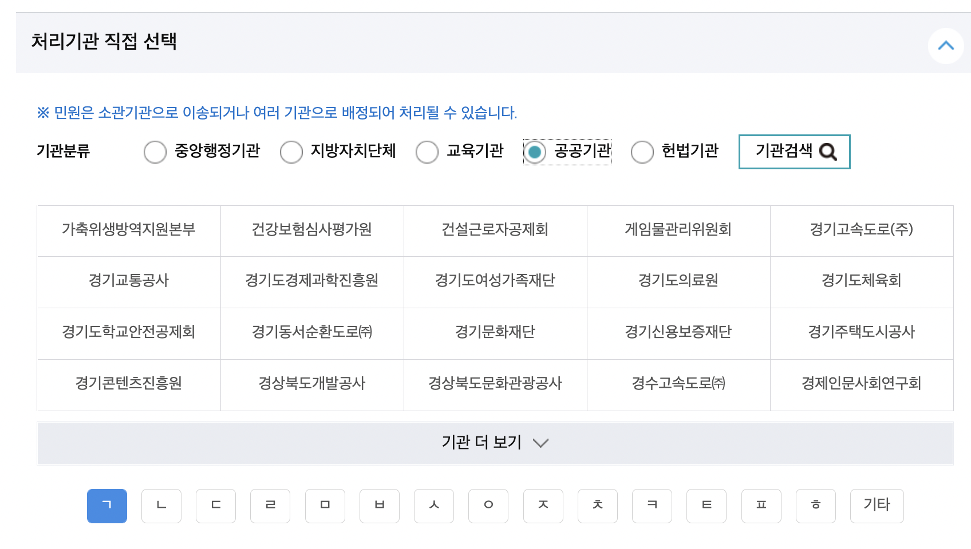
ePeople (국민신문고)
Currently operated as a system where the complainants decide the responsible institution for their own complaints
⇒ inconvenience ↑ mistakes ↑

Slide 28
6. Conclusion
Limitation
Data and methodology
Contribution
Subjectivity of Civil Complaints
Not comprehensive enough
Scattered sources
Number of Civil Complaints
Only 1000 data
Coordinates Problem
Use of pyautogui
Administration
Enhancement
Efficient, and prompt handling of civil complaints leads to better service provision of Seongdong-gu

Slide 29
6. Conclusion
- What we learned and suggestions
Topics for Machine Learning usage
Many pre-topics were turned down as they were not appropriate for machine-learning.
This project helped us to understand which social problems are applicable to machine-learning.
Implementation of classwork
We collected the data by ourselves through web crawling.
We learned the big-picture process of linking several different machine-learning models.
For Further Research
With enough time and cooperation, using data from every Civil Complaint source will be idealistic.
The stopword list can be improved by administrative expertise.

Slide 30
Thank You
This presentation template was created by Slidesgo,
including icons by Flaticon and infographics & images by Freepik

